Slide 1






WELCOME TO OUR
PRESENTATION
Presented by : Libray Management Project Team

Slide 2




TOPICS
Libray Management System

Slide 3
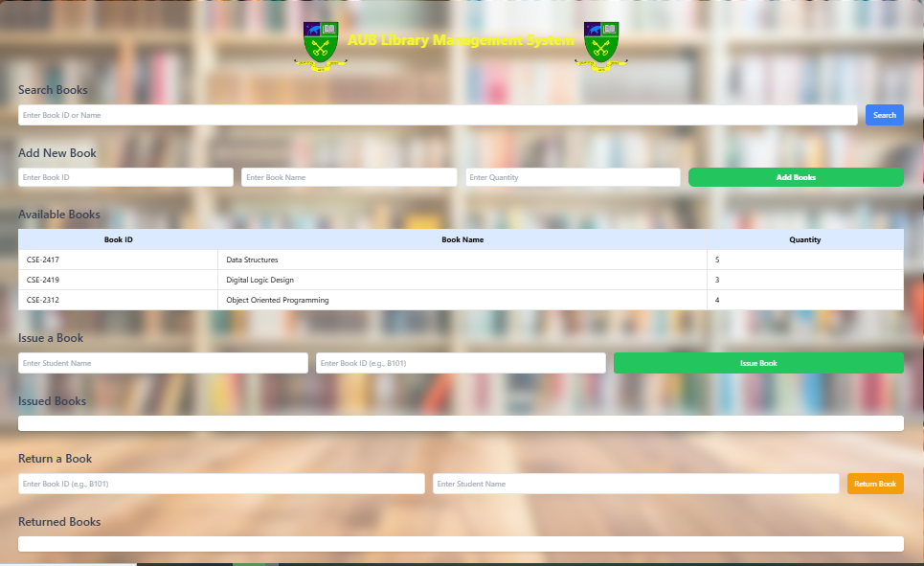
OUTPUT

Slide 4
1. Data Setup:
The books array holds book objects with properties like id, name, and quantity. We also initialize two arrays:
issuedBooksArray to store issued books.
returnedBooksArray to store books that are returned.

Slide 5
2. Display Books (displayBooks function):
This function displays the books in a table on the web page.
It first clears the existing content in the table, then loops over each book in the books array (this is iteration).
For each book, it creates a row and adds the book’s id, name, and quantity into that row.
This function is updating the display each time it’s called.

Slide 6
3. Search for a Book (searchBook function):
This function performs a linear search to find a book by id or name.
The function takes user input from searchInput and converts it to lowercase for easier matching.
It uses the find() method to look through each book in the books array (linear search) and checks if:
The id matches exactly, or
The name includes the search term.
If a match is found, it shows the book’s details; otherwise, it shows “Book Not Found!”

Slide 7
THANK YOU
Presented by : Libray Management Project Team

